Slide 1
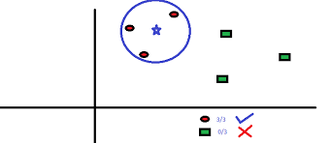
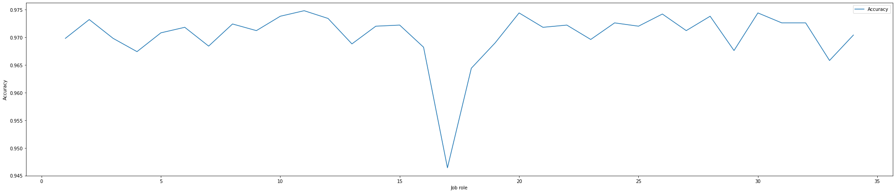
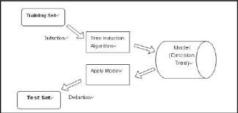
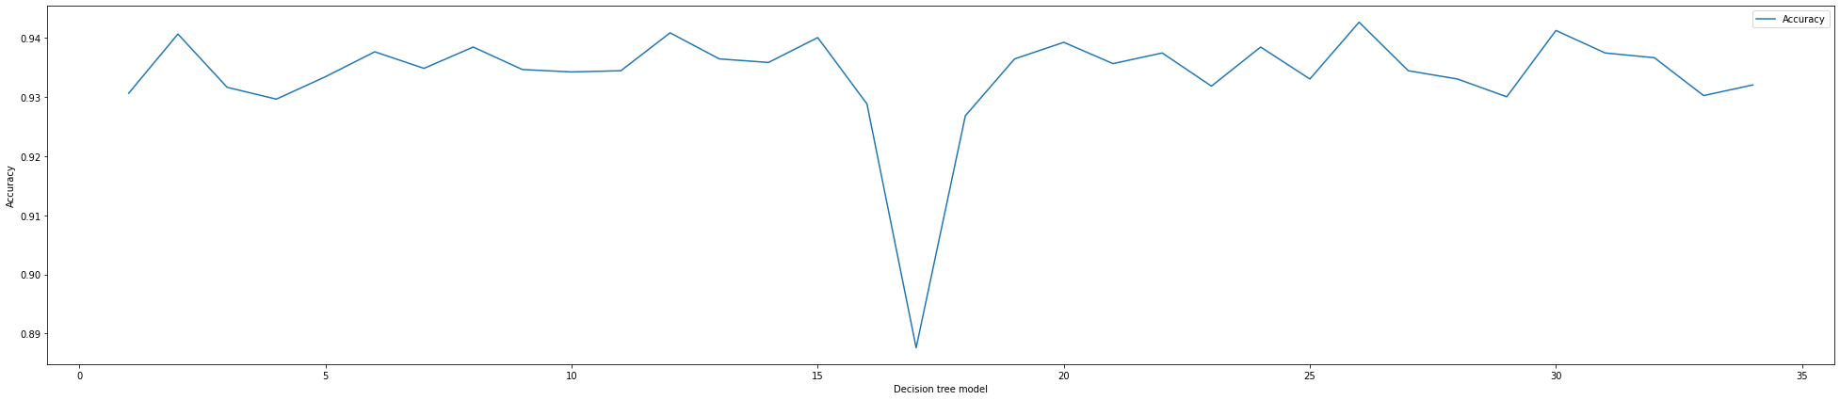
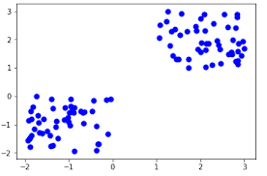
Job Role Prediction
MIT World Peace University
Dataset Description (Columns)
Student placement dataset from kaggle.
Released in April, 2020
Has 20,000 rows and 39 columns
that include
Academic marks
Hackathons/ Courses
Skills
Personality traits
Suggested Job role
Name: Aditya Desai
Roll: PC-15
Classification
Classification refers to a predictive modeling problem where a class label is predicted for a given example of input data.
Since I had more than 2 target labels, here 34, single classification model had very low accuracy.
For this MultiClass classification, I made a different classification model for each target label and trained/tested it against all the inputs.
K-Neighbors
K nearest neighbors is a simple algorithm that stores all available cases and classifies new cases based on a similarity measure (e.g., distance functions)
Decision Tree
Map observations about a data points features to determine its class. The tree is constructed to maximize the information gain of its decisions
Accuracy Graphs for K-Neighbors and Decision trees respectively
Preprocessing
Perform preprocessing on data to get data in proper/required format
SimpleImputer was used to fill missing values with the most frequent value.
Most of the data was categorical, but the classifiers needed numerical data. So used get_dummies() function to OneHotEncode the data.
The target field had 34 classes in total, for prediction. So had to encode it using sklearn.preprocessing.OneHotEncoder library class
KNN
Decision Tree
Libraries
Preprocessing
Classification/Clustering
Visualisations
sklearn.impute.SimpleImputer
sklearn.preprocessing.OneHotEncoder
seaborn.countplot
matplotlib.pyplot
Dimentionality Reduction
All the 39 columns were not useful/needed for classification. So removed 10 columns from the original dataset to help in faster processing of data in the classification techniques
pandas.dataFrame.get_dummies
sklearn.neighbors.KNeighborsClassifier
sklearn.tree.DecisionTree
sklearn.cluster.KMeans
Clustering
K means clustering has been implemented here. Since most of the data was categorical and OneHot Encoded, clustering was performed on the first 9 columns of the dataset that were originally numerical.
To reduce the dimentionality to 2, PCA was implemented.

